Slide 1
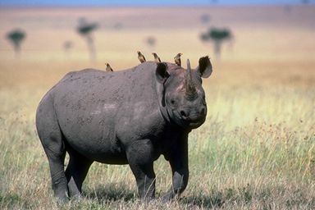
Relationships in Nature
Notes:
Notes:
Relationships can be found throughout nature:
Dependent and Independent
Beneficial and Harmful
Hosts and Parasites
Questions:
This rhino is in a variety of relationships some obvious and some less visible.
1) Can you name any of these partnerships?
2) What the purpose of the relationship?
3) Who does it harm or help?

Slide 2
What is symbiosis?
Literal definition: the act of living together
What it means:
Two organisms that live together
Temporarily or for a longer time
At least one of the organisms benefits from the relationship

Slide 3
What are the different kinds of symbiosis?
Mutualism
Commensalism
Parasitism
both organisms benefit
one organism benefits
one organism benefits
one organism is unaffected
one organism is harmed

Slide 4
Mutualism
Both organisms derive mutual benefit
Intimate and obligatory
Neither can survive without the other

Slide 5
Clownfish & Sea Anemone
The sea anemone protects the clownfish from predators, as well as providing food through the scraps left from the anemone's meals and occasional dead anemone tentacles.
In return, the clownfish defends the anemone from its predators, and parasites

Slide 6
Ex. Bee & Flower
Bee & Flower
The bee gains nectar from the flower for survival, as it uses the bee to carry its pollen to other flowers. So both organisms living together benefit from their existence.

Slide 7
Humans & Gut Bacteria
Gut microbiota (formerly called gut flora) is the name given today to the microbe population living in our intestine
Some of the functions are:
It helps the body to digest certain foods that the stomach and small intestine have not been able to digest.
It helps with the production of some vitamins (B and K).
It helps us combat aggressions from other microorganisms, maintaining the wholeness of the intestinal mucosa.
It plays an important role in the immune system, performing a barrier effect.
A healthy and balanced gut microbiota is key to ensuring proper digestive functioning.

Slide 8
Crocodile & Bird
Nile crocodile
Usually eats animals
Allows bird to walk around its mouth
Crocodile bird
Cleans parasites in croc’s teeth
Removes and eats scraps of food
Eats harmful leeches and parasites
Notes:
Notes:
Mammal - Bird relationships are common.
Questions:
Can you think of other animal-bird symbiotic relationships?
Why and how do you think this relationship evolved?
What special adaptations might have developed for this relationship?

Slide 9
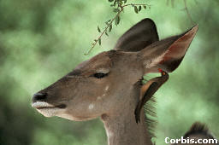
Mutualism: both benefit
Antelope with Oxbird
Antelope gets rid of parasites Oxbird gets a meal

Slide 10
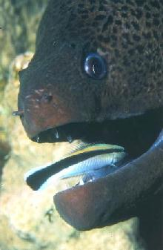
Mutualism: both benefit
Moray Eel with Cleaner Fish
Moray Eel gets a clean mouth
Cleaner Fish gets a meal

Slide 11
Zebra & Ostriches
The ostrich always moves with the herd of zebras since it has a poor sense of hearing and smell, whereas the zebra has very sharp senses. The ostrich has a keen sense of sight, which the zebra lacks.

Slide 12
Lichen
Slow growing plants
Partnership: fungi & algae
Neither could live alone

Slide 13
Commensalism
Means “eating together at the same table”
Only one member benefits
sharing space, defense, shelter, food
Neither will die if relationship is ended
http://www.ms-starship.com/sciencenew/symbiosis.htm

Slide 14
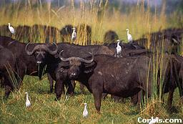
Cattle with cattle egrets
Cattle stir up insects as they eat grass Egrets hang around and eat insects
Commensalism: one benefits, one is unaffected

Slide 15
Shark and Remora Fish
Shark
Lets the fish eat
Remora Fish
Eats parasites
Gets the shark’s leftovers

Slide 16
Lion & Vulture
Once the lion has finished its meal, the vulture swoops down and finishes off the carcass. The lion is not affected by this while the vulture gets to eat.

Slide 17
Buffalo & Oxpecker
Buffalo
Lets the bird eat
Oxpecker
Eats ticks and other parasites off skin
Warns buffalo of danger
http://www.pbs.org/wnet/nature/enemies/partners.html

Slide 18
Hermit Crab & Sea Anemone
Young hermit crabs will often pick up a young sea anemone to attach to their shell and they become partners for life. They even grow at roughly the same rate. When hermit crabs outgrow their shell, they often take the sea anemone with them to the new one.
Some sea anemones have gone so far as to cover most of the surface of the hermit crab’s shell so when the crab eventually outgrows the shell, he doesn’t have to move.

Slide 19
Parasitism
Causes harm to host
Parasites are completely dependent on a host for survival.
The relationship is beneficial to one, and harmful to the other.
Parasites may live outside or inside a host; they are called ectoparasites (the prefix ecto means outside) and endoparasites (theprefix endo means inside).

Slide 20
Dog Parasites

Slide 21
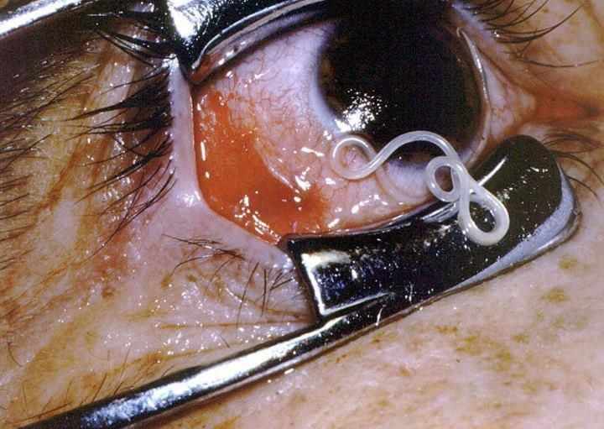
Taenia worm in human eye
Worm infects human blood stream Human may go blind
Parasitism: one benefits, one is harmed

Slide 22
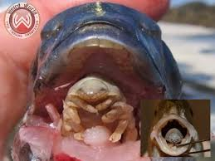
Cymothoa exigua
This parasite actually eats its host’s tongue and lives in the mouth or gills, which is vile.
Inside the mouth, the louse attaches herself to the fish’s tongue by its front claws and begins drinking blood, causing the tongue to shrivel away. The louse then latches herself to the tongue stub and sits in its place, replacing the organ. The louse lives by parasitically feeding on the fish’s blood or its mouth mucus, while the host fish appears to live a normal life and can use the louse as it would its own tongue.

Slide 23
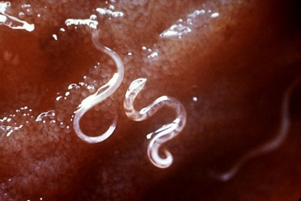
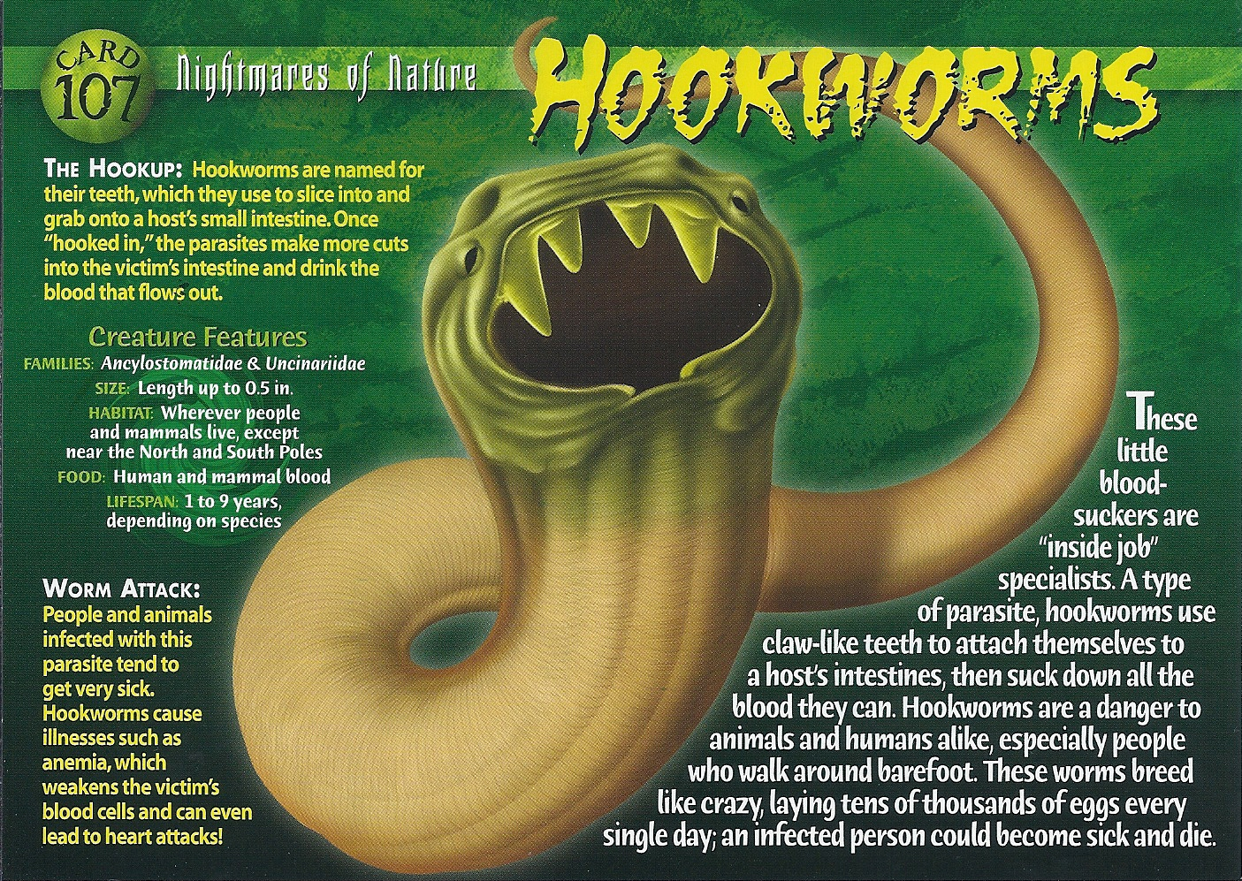
Hookworms

Slide 24
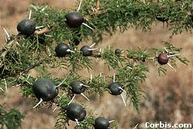
Acacia plant with ant galls
Ants lay eggs on acacia tree Acacia covers the infected area with brown flesh (gall)
Parasitism: one benefits, one is harmed

