Slide 1
Evaluate the following materials to see if they are minerals. Record your findings of the sheet provided.
Click here
to continue

Slide 2
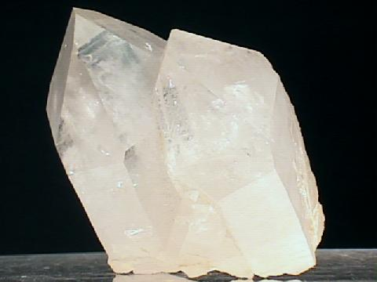
1. Quartz (Silicon Dioxide)
Observe/examine the material.
Think about what you already know about the material.
Click here
to continue

Slide 3
Is this a material that is found in nature?
Yes
No

Slide 4
QUARTZ (Silicon Dioxide)
Be sure to click on the individual pictures of quartz specimens
Back to
the question

Slide 5
Is this material organic or inorganic?
Organic
Inorganic

Slide 6
Is this material an element or compound with a definite chemical composition?
(When you look at the material do you see one substance or many?)
Yes
No

Slide 7
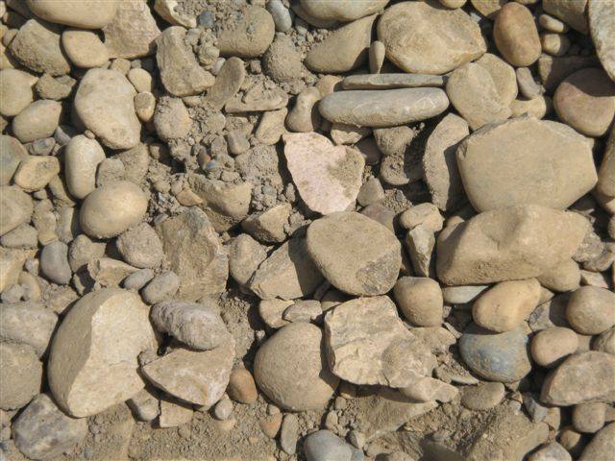
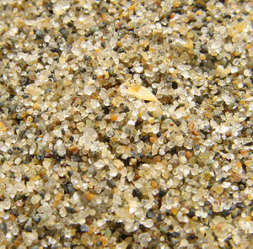
These are clearly not one element!
Click
for more
examples

Slide 8
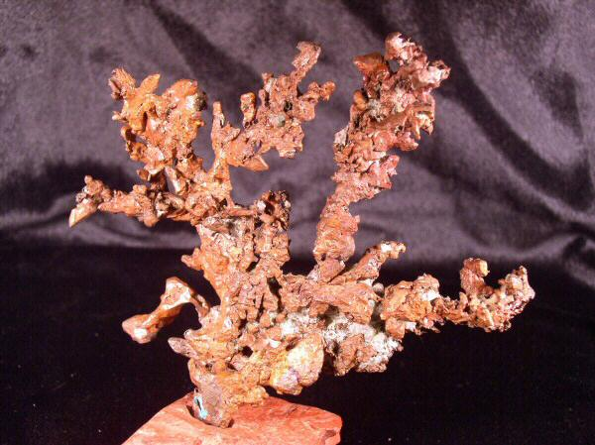
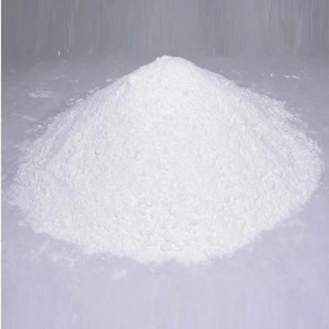
These materials are one single element or compound
Copper Crystals
Zinc Oxide
Back to
the question

Slide 9
Does this material have a crystalline structure?
Yes
No

Slide 10
Is quartz a mineral?
Yes
No

Slide 11
You are correct! Quartz is the most common mineral on the face of the earth.
Click here
to continue

Slide 12
Sorry, that’s incorrect. Go back and try again.
Click here
to try again

Slide 13
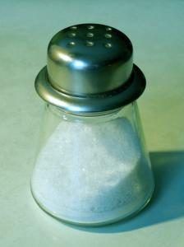
2. Salt (Sodium Chloride)
Observe/examine the material.
Think about what you already know about the material.
Click here
to continue

Slide 14
Is this a material that is found in nature?
Yes
No

Slide 15
Halite (Sodium Chloride)
Be sure to scroll down to see photos and read some descriptions
Back to
the question

Slide 16
Is this material organic or inorganic?
Organic
Inorganic

Slide 17
Is this material an element or compound with a definite chemical composition?
(When you look at the material do you see one substance or many?)
Yes
No

Slide 18
These are clearly not one element!
Click
for more
examples

Slide 19
These materials are one single element or compound
Copper Crystals
Zinc Oxide
Back to
the question

Slide 20
Does this material have a crystalline structure?
Yes
No

Slide 21
Is salt a mineral?
Yes
No

Slide 22
You are correct! Salt comes from the mineral Halite.
Click here
to continue

Slide 23
Sorry, that’s incorrect. Go back and try again.
Click here
to try again

Slide 24
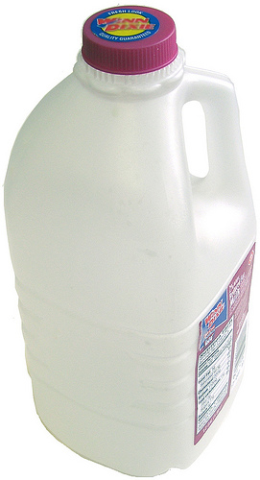
3. Plastic (High density polyethlyene)
Observe/examine the material.
Think about what you already know about the material.
Click here
to continue

Slide 25
Is this a material that is found in nature?
Yes
No

Slide 26
High-density polyethylene (HDPE plastic)
Back to
the question

Slide 27
Is this material organic or inorganic?
Organic
Inorganic

Slide 28
Click here to learn where petroleum comes from
Back to
the question

Slide 29
Is this material an element or compound with a definite chemical composition?
(When you look at the material do you see one substance or many?)
Yes
No

Slide 30
These are clearly not one element!
Click
for more
examples

Slide 31
These materials are one single element or compound
Copper Crystals
Zinc Oxide
Back to
the question

Slide 32
Does this material have a crystalline structure?
Yes
No

Slide 33
Is High Density Polyethylene (HDPE) a mineral?
Yes
No

Slide 34
You are correct! High Density Polyethylene is not a mineral.
It comes from petroleum, which comes from plants and animals. It does not have crystals and it is not found in nature.
Click here
to continue

Slide 35
Sorry, that’s incorrect. Go back and try again.
Click here
to try again

Slide 36
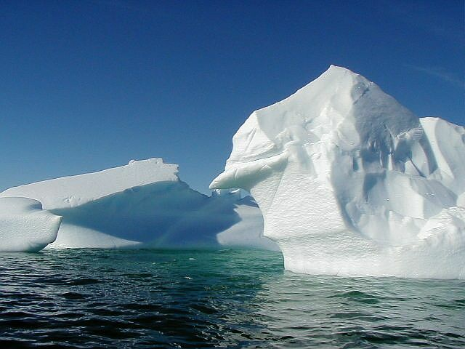
4. Ice (Hydrogen oxide)
Observe/examine the material.
Think about what you already know about the material.
Click here
to continue

Slide 37
Is this a material that is found in nature?
Yes
No

Slide 38
Ice (Solid H₂0)
Back to
the question

Slide 39
Is this material organic or inorganic?
Organic
Inorganic

Slide 40
Is this material an element or compound with a definite chemical composition?
(When you look at the material do you see one substance or many?)
Yes
No

Slide 41
These are clearly not one element!
Click
for more
examples

Slide 42
These materials are one single element or compound
Copper Crystals
Zinc Oxide
Back to
the question

Slide 43
Does this material have a crystalline structure?
Yes
No

Slide 44
Is Ice a mineral?
Yes
No

Slide 45
Surprise! Ice is a mineral
However, H2O in its liquid state (water) is not a mineral.
Click here
to continue

Slide 46
Sorry, that’s incorrect. Go back and try again.
Click here
to try again

Slide 47
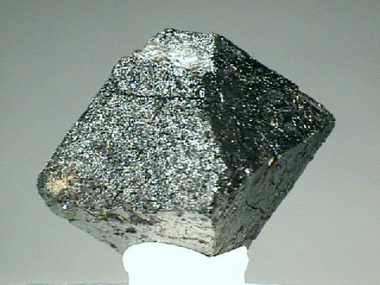
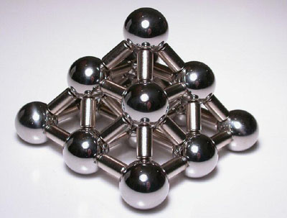
4. Magnets (Magnetite - Iron oxide)
Observe/examine the material.
Think about what you already know about the material.
Click here
to continue

Slide 48
Is this a material that is found in nature?
Yes
No

Slide 49
Magnetite
Notice the large crystals in the picture
Back to
the question

Slide 50
Is this material organic or inorganic?
Organic
Inorganic

Slide 51
Is this material an element or compound with a definite chemical composition?
(When you look at the material do you see one substance or many?)
Yes
No

Slide 52
These are clearly not one element!
Click
for more
examples

Slide 53
These materials are one single element or compound
Copper Crystals
Zinc Oxide
Back to
the question

Slide 54
Does this material have a crystalline structure?
Yes
No

Slide 55
Is a magnet a mineral?
Yes
No

Slide 56
Correct! Iron oxide or magnetite is one mineral with magnetic properties.
Click here
to continue

Slide 57
Sorry, that’s incorrect. Go back and try again.
Click here
to try again

Slide 58
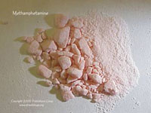
6. Crystal Meth (methamphetamine)
Observe/examine the material.
Think about what you already know about the material.
Click here
to continue

Slide 59
Is this a material that is found in nature?
Yes
No

Slide 60
Some ingredients in meth:
Ether (starting fluid)
Benzene
Paint thinner
Freon (used in air conditioners, harmful to environment)
Acetone (nail polish remover)
Chloroform
Camp stove fuel
Anhydrous ammonia
Back to
the question

Slide 61
Is this material organic or inorganic?
Organic
Inorganic

Slide 62
Is this material an element or compound with a definite chemical composition?
Yes
No

Slide 63
Is this material an element or compound with a definite chemical composition?
Although it’s true that meth is a collection of chemicals, it’s make-up varies. You cannot tell by looking if it contains more or less of any toxic substance.
For now, click “No”
No

Slide 64
Does this material have a crystalline structure?
Yes
No

Slide 65
Is a meth a mineral?
Yes
No

Slide 66
Correct! Meth is not a mineral, but an extremely dangerous man-made substance.
Click here
to continue

Slide 67
Sorry, that’s incorrect. Meth is a highly unnatural and dangerous substance.
Click here
to try again

Slide 68
Sorry, that’s incorrect. It is unlikely that a living thing could survive if it contained the ingredients in meth.
Click here
to try again

Slide 69
Think carefully. All minerals are crystals, but not all crystals are minerals!
Click here
to try again

Slide 70
Sorry, that’s incorrect. Go back and try again.
Click here
to try again

Slide 71
Thanks for playing.
I hope you have a better understanding about what a mineral is or is not!
Click here
to end

Slide 72
What is this mineral?
Mystery Mineral!
Gold?
Something
Else?

Slide 73
Fooled ya!
This is a mineral known as Iron Pyrite, or Fool’s Gold.
Try again!
Click
To
continue

Slide 74
Correct! This is a mineral known as Iron Pyrite – more commonly known as Fool’s Gold!
Click
to continue

Slide 75
Azurite (Hydrated Copper Carbonate)
Note: Click the back button on your browser when you finish viewing the mineral
Uses: ornamental stone, pigment, minor ore of copper, and jewelry.
Click
To
continue

Slide 76
The mineral corundrum embedded in rock Note: Click the back button on your browser when you finish viewing the mineral
Uses: As a gemstone, mineral specimens and as an abrasive.
Click
To
continue

Slide 77
References
"Amethyst Galleries Mineral Gallery, The First Internet Rock Shop". Amethyst Galieries, Inc.. October 1, 2009 <http://mineral.galleries.com/>.
http://weathersavvy.com/Salt_TableSalt.jpg
http://www.mii.org/Minerals/photosalt.html
http://www.galleries.com/minerals/oxides/magnetit/mag-14.jpg
http://www.unitednuclear.com/magnets.htm
http://www.flickr.com/photos/re3org/2324089321/
http://www.bottle2bottle.com/making-hdpe.asp
http://kids.yahoo.com/reference/encyclopedia/entry?id=petroleu
Canipe, Steve. iceberg4.jpg. 8/25/2001. Pics4Learning. 4 Oct 2009 <http://pics.tech4learning.com>

